Slide 1

Insights to Guide Bharat Herald’s Survival in a Post- COVID Digital Era
Aleeja Ambili

Slide 2



01
COVID-19's Impact on Print Media

Slide 3

COVID-19's Impact on Print Media
Studies suggest that 50% of the media companies have lost about 90% of their business since March 2020.
More than 80% of advertising revenue has been lost for most publications.
The pandemic-induced lockdowns caused major disruptions in the circulation of print newspapers and magazines.

Slide 4

02
Adaptation Strategies Adopted by Indian Print Media

Slide 5


Adaptation Strategies Adopted by Indian Print Media
Digital Transformation and Hybrid Models: As physical circulation declined, print media organizations hastened their move to digital platforms.
Content Strategy Shifts: The focus of print media shifted towards health-related content and updates about COVID-19.
Introduction of Paywalls and Subscription Models: The financial strain from reduced ad revenue encouraged some print media organizations to adopt paywalls for digital content.

Slide 6

03
Problem Statement

Slide 7

Problem Statement
Bharat Herald, a legacy newspaper organization with operations across five Indian states, is facing an existential crisis. With a reputation built over seven decades for multilingual reporting and sharp regional journalism, the company once printed over 1.2 million copies daily. But between 2019 and 2024, print circulation has dropped to under 560,000. The pandemic accelerated a shift toward digital news consumption, and competitors like DigiHindi Post, NewsZilla, and InShorts quickly adapted with mobile-first platforms, WhatsApp delivery models, and subscription bundles. Meanwhile, Bharat Herald’s 2021 e-paper pilot failed due to poor mobile usability and was eventually shelved after financial losses. The result: advertiser confidence declined, vendor payments delayed, and multiple city bureaus shut down. Over 60 employees across editorial and sales functions have been let go. A recent internal audit flagged severe fiscal concerns.

Slide 8

04
What to Do

Slide 9


What to Do
Quantify what went wrong.
Identify recovery potential.
Recommend a phased roadmap toward digital transformation.

Slide 10

05
Analysis

Slide 11
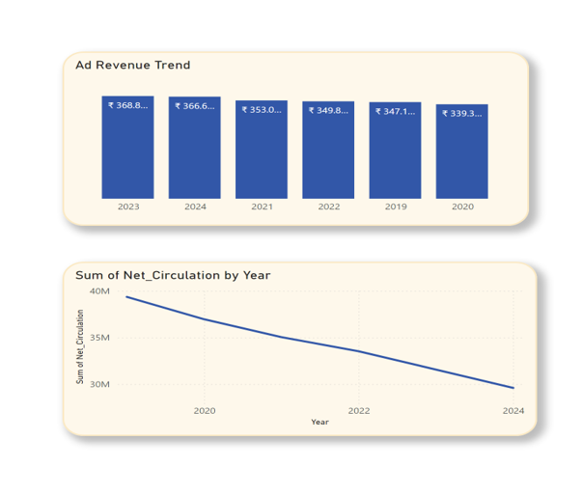
Summary
Ad Revenue drop from 2019-2024 = -5.61%.
Circulation Drop from 2019-2024 = -24.79%.

Slide 12
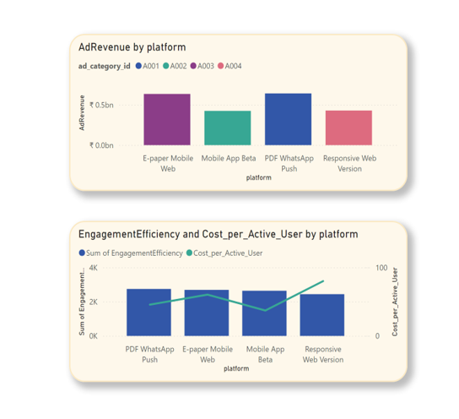
Ad Revenue Insights
The digital pilot proved audience demand exists, but failed on execution (65.7% avg. bounce rate).
The 'PDF WhatsApp Push' had the highest engagement, showing an appetite for mobile-first delivery.
High engagement efficiency is negatively correlated with cost-per-user, meaning efficient platforms are cheaper to run

Slide 13

06
Print Circulation Trends

Slide 14
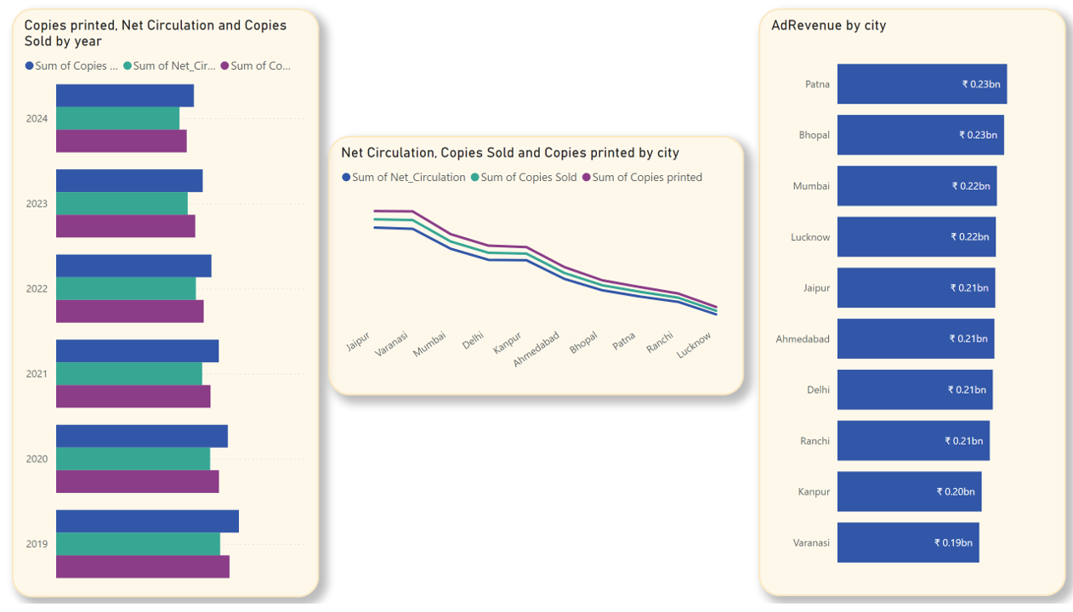
Print Circulation Trends
CIRCULATION
Jaipur has the highest circulation but also significant waste.
Lucknow & Ranchi are the lowest circulation cities.
Insight: High volume doesn't equal high efficiency or profitability
REVENUE
Patna consistently leads ad revenue.
Insight: Advertiser confidence is stagnant; revenue is flat despite circulation drops.

Slide 15

07
2019 vs 2024

Slide 16
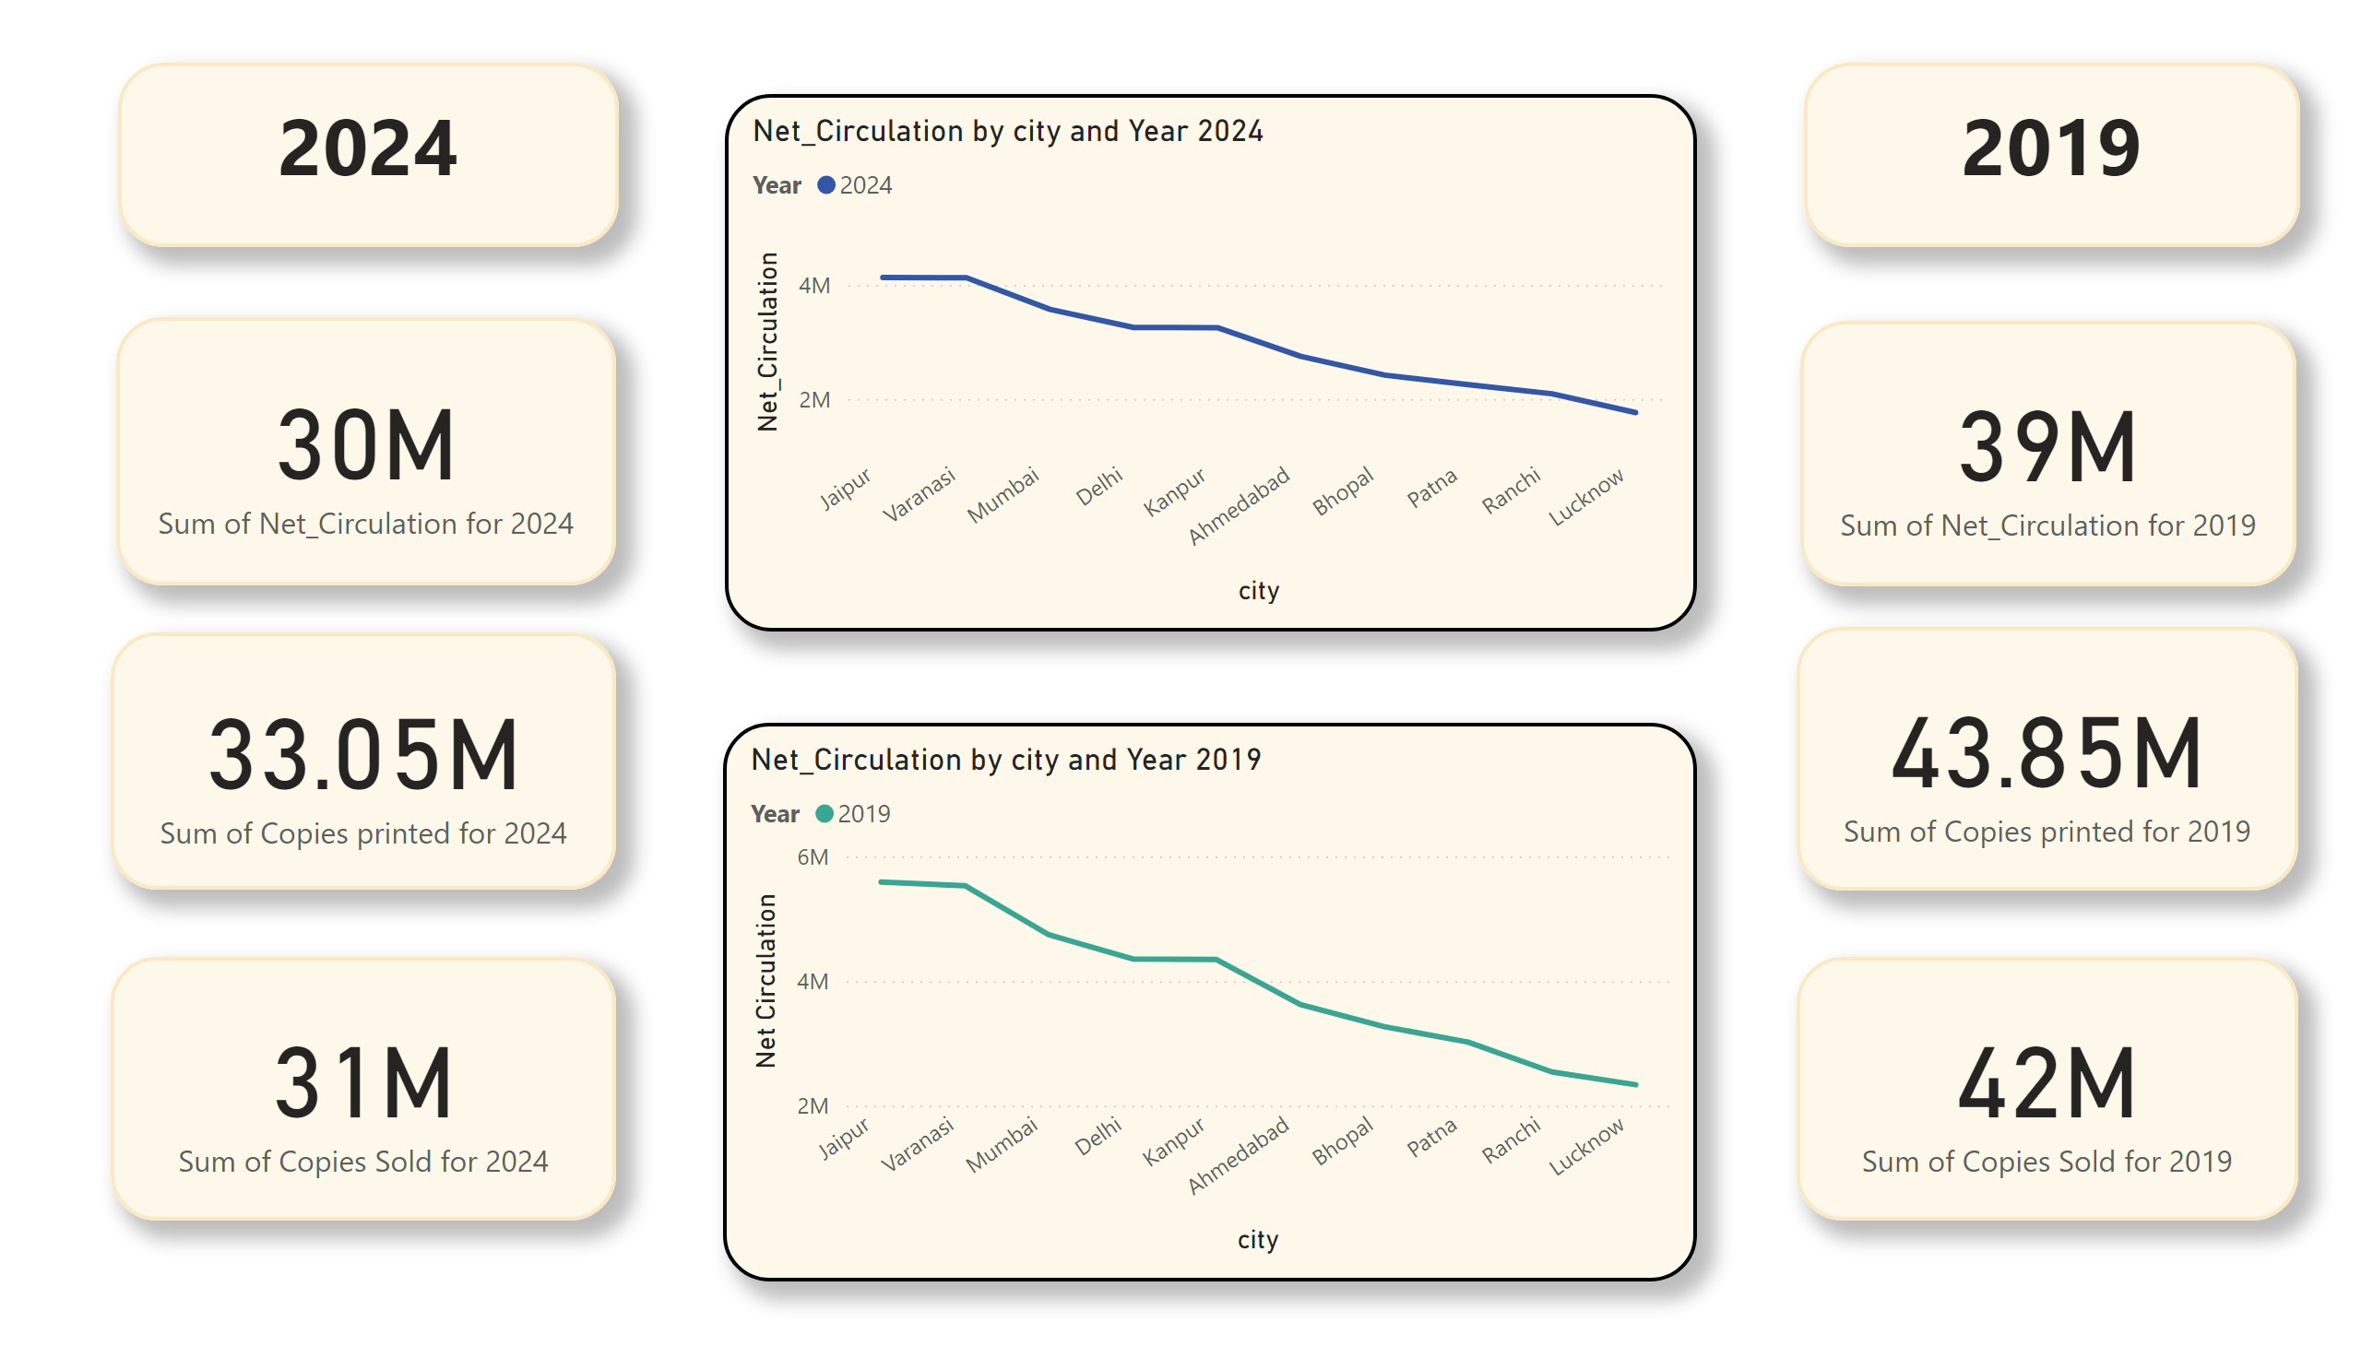
2019 vs 2024
The gap between printed and circulated copies widened → print waste rising (~10%). Peak decline during pandemic years (2020–2021), recovery was weak.
Print dependency is unsustainable — waste is eating costs while reach declines.
Pattern is the same but the decline is clear, print scale is shrinking, advertiser confidence is shifting . Digital shift is urgent to protect revenues and regain Tier-1 markets.

Slide 17

08
Print Waste Analysis

Slide 18
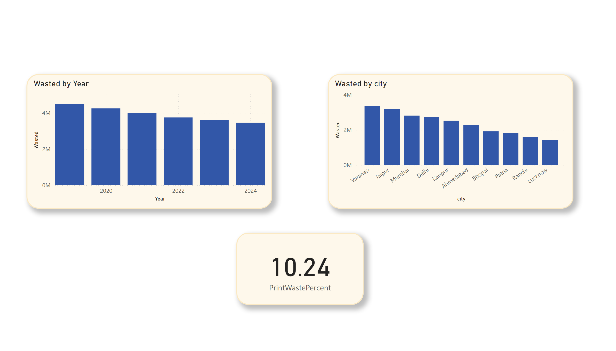
Print Waste Analysis
The gap between printed and circulated copies widened since 2019.
Print waste is steadily rising (~10%).
Insight: The print model is becoming increasingly inefficient, eating into costs.

Slide 19

09
Ad Revenue Trends by Category

Slide 20
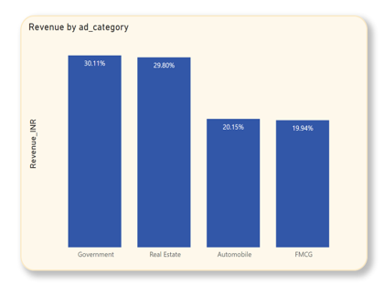
Ad Revenue Trends by Category
Government & Real Estate dominate categories (>60%).

Slide 21

10
City-Level Ad Revenue Performance

Slide 22
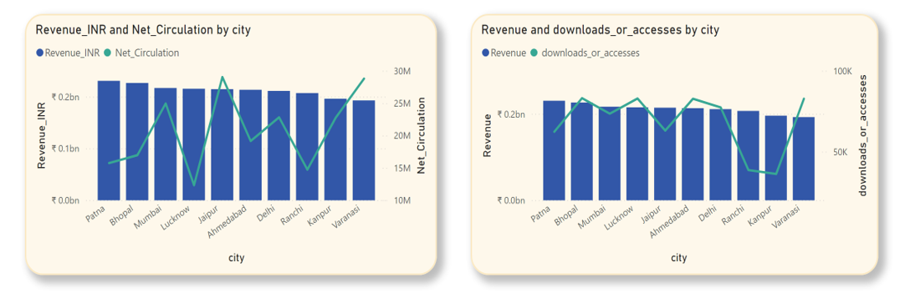
City-Level Ad Revenue Performance

Slide 23

11
Digital Pilot

Slide 24
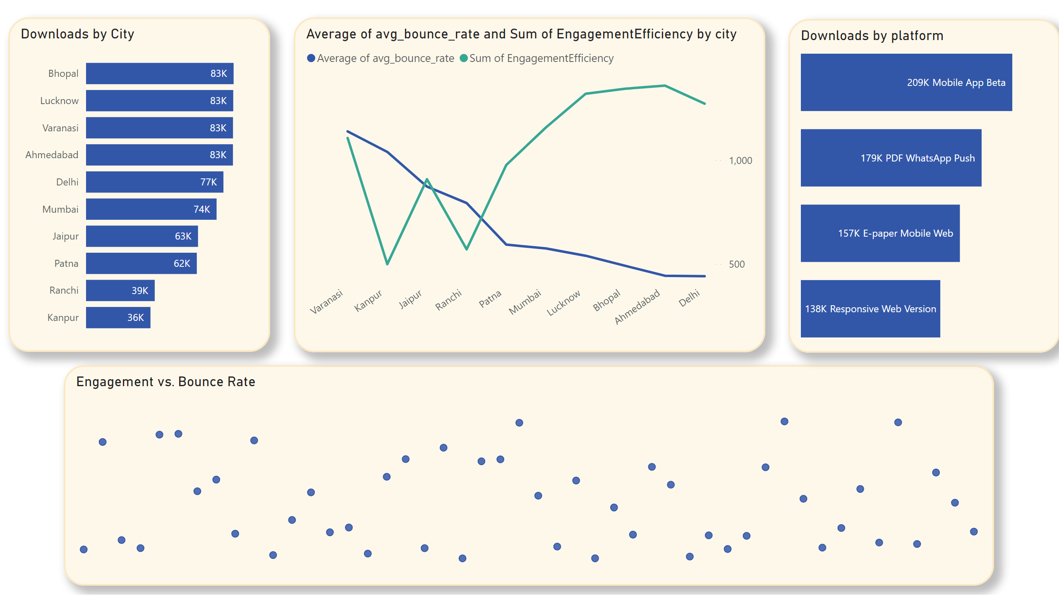



Digital Pilot
683K downloads across platforms (2019–2024).
1
2
WhatsApp Push + Mobile App Beta drove \~60% of adoption.
Avg bounce rate = 65.7% → weak user experience.
3
4
Message: Pilot proved demand exists but execution failed – poor mobile usability, high churn.
Engagement Efficiency: Ahmedabad strongest, Delhi/Patna weakest.

Slide 25

12
Digital Readiness vs. Performance

Slide 26
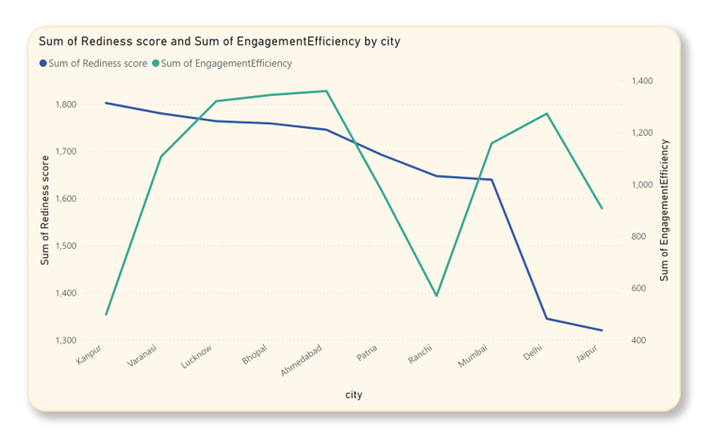
Digital Readiness vs. Performance

Slide 27

13
Ad Revenue vs. Circulation ROI

Slide 28
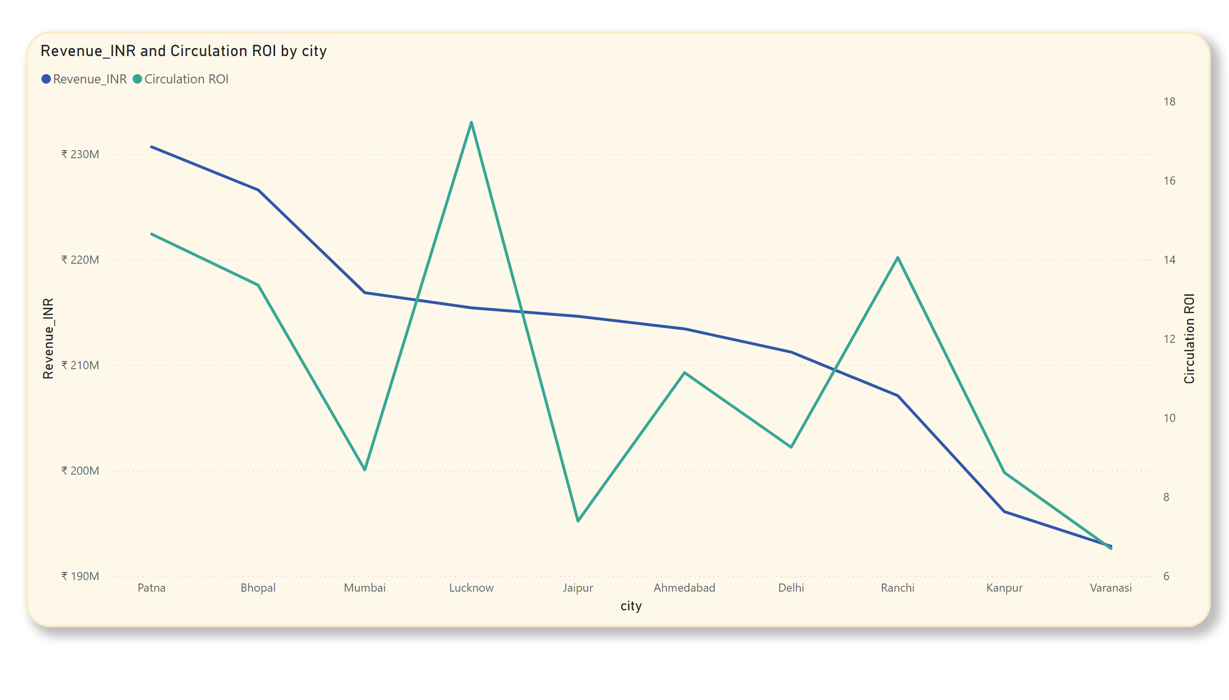
Ad Revenue vs.
Circulation ROI

Slide 29

14
ROI Comparison

Slide 30
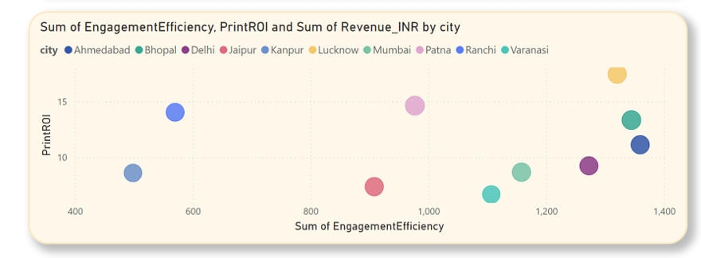
ROI Comparison

Slide 31
15
Digital Relaunch City Prioritization

Slide 32
Digital Relaunch City Prioritization
City | Rediness score | EngagementEfficiency | avg_bounce_rate,
Delhi | 1345.13 | 1272.49704 | 60.808
Ahmedabad | 1745.64 | 1359.533298 | 60.8525
Bhopal | 1758.906667 | 1344.620612 | 61.81
Lucknow | 1763.866667 | 1320.447885 | 62.784
Mumbai | 1639.8 | 1157.961884 | 63.49
Patna | 1692.643333 | 977.0726971 | 63.854
Ranchi | 1647.33 | 570.0350691 | 67.866
Jaipur | 1320.396667 | 908.0660024 | 69.452
Kanpur | 1802.37 | 498.4889695 | 72.798
Varanasi | 1780.29 | 1106.790144 | 74.7775
Target Cities: Bhopal, Ahmedabad, Lucknow.

Slide 33
16
Phased Digital Strategy

Slide 34
Phase 1: Targeted Relaunch and Optimization
Target cities for digital relaunch:
City | Rediness score | EngagementEfficiency | avg_bounce_rate,
Delhi | 1345.13 | 1272.49704 | 60.808
Ahmedabad | 1745.64 | 1359.533298 | 60.8525
Bhopal | 1758.906667 | 1344.620612 | 61.81
Lucknow | 1763.866667 | 1320.447885 | 62.784
Mumbai | 1639.8 | 1157.961884 | 63.49
Patna | 1692.643333 | 977.0726971 | 63.854
Ranchi | 1647.33 | 570.0350691 | 67.866
Jaipur | 1320.396667 | 908.0660024 | 69.452
Kanpur | 1802.37 | 498.4889695 | 72.798
Varanasi | 1780.29 | 1106.790144 | 74.7775
Target Cities: Bhopal, Ahmedabad, Lucknow.
Action: Develop and launch a revamped, mobile-first platform with a superior user experience.
Focus: Fix usability issues, optimize WhatsApp delivery, and create a seamless interface.

Slide 35
Cities for Print Optimization
city | Net_Circulation | Copies Sold | Copies printed | Wasted | Revenue
Ahmedabad | 19155753 | 20300075 | 21444397 | 2288644 | ₹ 21,34,27,962.44
Bhopal | 16969882 | 17929108 | 18888334 | 1918452 | ₹ 22,65,87,269.24
Delhi | 22821731 | 24191122 | 25560513 | 2738782 | ₹ 21,12,29,274.61
Jaipur | 29032754 | 30621736 | 32210718 | 3177964 | ₹ 21,46,13,092.38
Kanpur | 22759261 | 24020911 | 25282561 | 2523300 | ₹ 19,61,08,317.78
Lucknow | 12333385 | 13042076 | 13750767 | 1417382 | ₹ 21,54,21,898.13
Mumbai | 24961046 | 26367469 | 27773892 | 2812846 | ₹ 21,68,53,971.12
Patna | 15753919 | 16666001 | 17578083 | 1824164 | ₹ 23,06,71,630.51
Ranchi | 14740028 | 15542659 | 16345290 | 1605262 | ₹ 20,70,94,252.22
Varanasi | 28796638 | 30473427 | 32150216 | 3353578 | ₹ 19,28,33,810.66
Target Cities: Jaipur, Patna, Mumbai.
Action: Streamline print operations in high-volume markets to maximize profitability.
Focus: Reduce print waste, optimize distribution, and secure revenue from top ad categories.

Slide 36


Phase 2: Content Diversification
Diversifying content and revenue streams, new content formats and delivery methods
Develop mobile-first content like video shorts, regional language content, and podcasts to cater to
modern consumption habits.
.

Slide 37
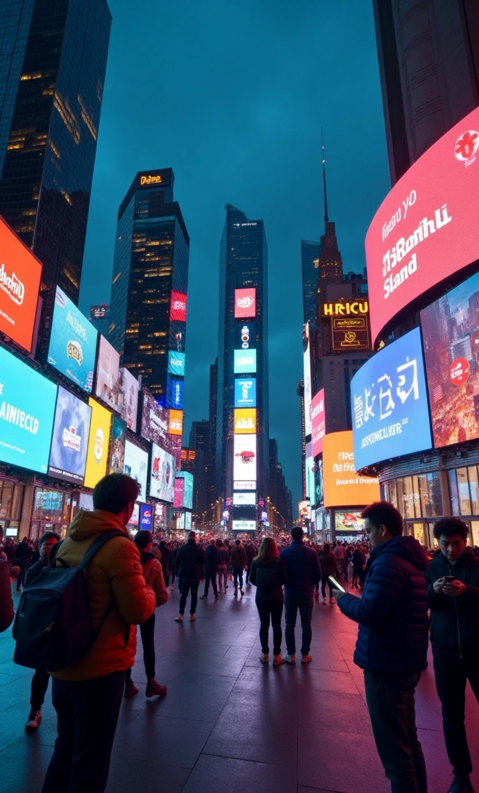
Phase 3: Scale & Monetize
Scaling the successful digital model to other cities and fully monetizing the platform through subscriptions or loyalty programs
With an engaged audience and a proven model, the final phase involves expanding the platform's reach and building direct revenue streams to ensure long-term sustainability.
Scale
Roll out the successful digital model to remaining cities like Mumbai, Delhi, and Patna.
Monetize
Introduce reader revenue models to diversify income and reduce ad dependency.
.

Slide 38
17
Advertiser Trust

Slide 39
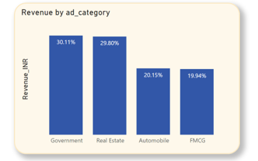
Focus on Top Ad Categories
Tailor solutions for high-value advertisers in government and real estate

Slide 40
Provide Transparent Data
Provide advertisers with clear, actionable data on digital engagement and ROI.

Slide 41
18
Changes to Content Format or Delivery

Slide 42
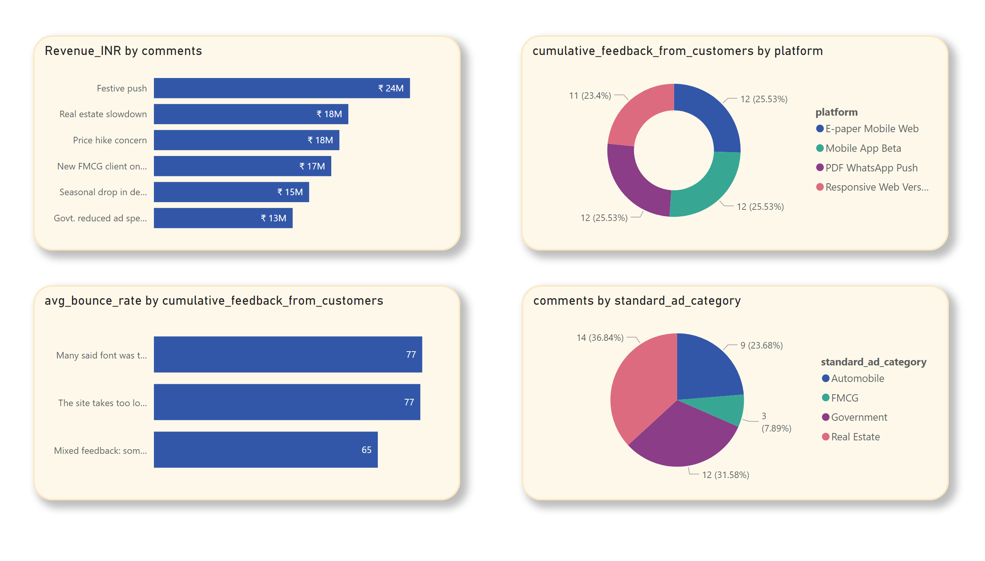
Changes to Content Format or Delivery

Slide 43
19
Role of Subscription Bundling, Loyalty Programs, or Pay-per-Article

Slide 44





Role of Subscription Bundling, Loyalty Programs, or Pay-per-Article
Direct reader revenue diversifies income, lowers ad dependency.
1
2
3
Subscription Bundling: By offering a bundle that includes both a digital subscription and a loyalty program, Bharat Herald can tap into two revenue streams at once.
Pay-Per-Article Model: This model could be tested in a few select cities to gauge user interest. It is a good option for highly specialized or exclusive content, allowing Bharat Herald to generate revenue from premium content without forcing users to commit to a full subscription.
Loyalty Programs: A loyalty program can increase customer lifetime value and create a direct relationship with the audience.

Slide 45
20
Leveraging Local Influencers or Journalists to Re-establish Digital Credibility in Regional Markets

Slide 46





Leveraging Local Influencers or Journalists to Re-establish Digital Credibility in Regional Markets
1
2
3
Identify Top-Performing Cities: Identify which regional markets are most critical for the business. This is where the initial focus should be for influencer partnerships.
Re-engage with Key Journalists: Bharat Herald should identify their most respected and well-known local journalists and empower them to create digital-first content.
Partnership with Influencers: By partnering with local influencers who have a strong digital following, Bharat Herald can tap into new audiences and build credibility in regional markets.

Slide 47
21
From Survival to Sustainability

Slide 48

The decline in print is irreversible, but a clear demand for Bharat Herald's journalism exists in the digital space. By executing this phased transformation—starting with a targeted relaunch, diversifying content, and scaling monetization—the organization can build a sustainable and profitable future.

Slide 49
22
Bibliography

Slide 50

Bibliography
https://inspirajournals.com/uploads/Issues/996724634.pdf
https://iju.org.in/media-room/issues/244-role-of-media-during-the-covid-19-pandemic-and-its-impact-on-media
http://vendigital.com/wp-content/uploads/2020/03/COVID-19-and-the-Impact-on-Print-Media.pdf
https://www.hhs.se/en/about-us/news/site-publications/2024/covid-19-and-media-coverage-in-sweden/

Slide 51
Thank You

